Slide 1
Personality prediction using deep learning
Imran Khan
Hammad Rehman Saad
Tanzeel Ahmad

Slide 2
Introduction
Text based classification
Image based classification
Mood prediction

Slide 3
Problem Statement
Some popular measures are invalid
We are introducing a better approach

Slide 4
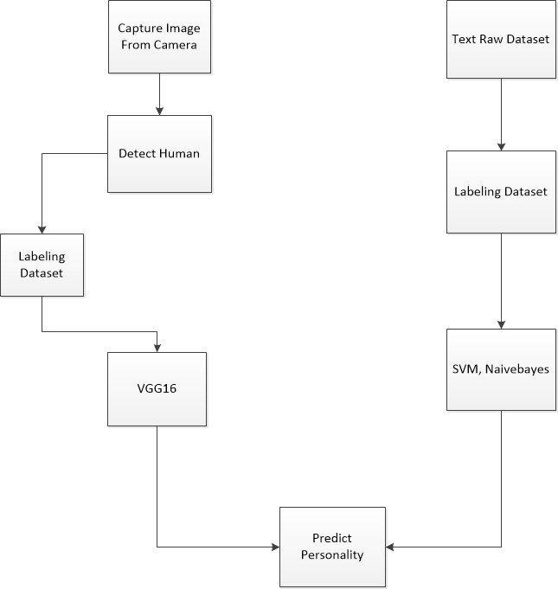
Proposed solution

Slide 5
Project Scope
Data collection
Pre-processing
Classification
Mood prediction
Personality predication

Slide 6
Project Objectives
Forming, Testing and Training of Textual dataset
Forming, Image Training and Image Testing
Image Processing
Text Classification
Personality Classification
Mood Prediction

Slide 7
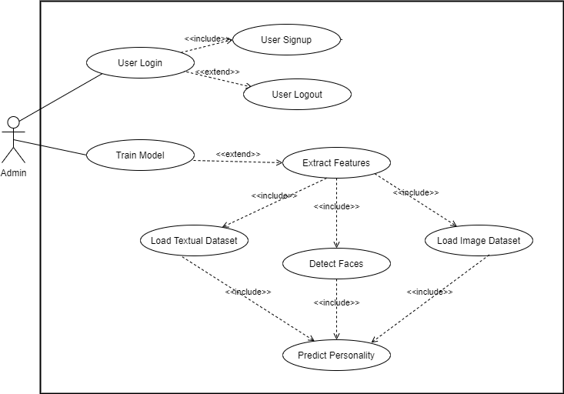
Use Case

Slide 8
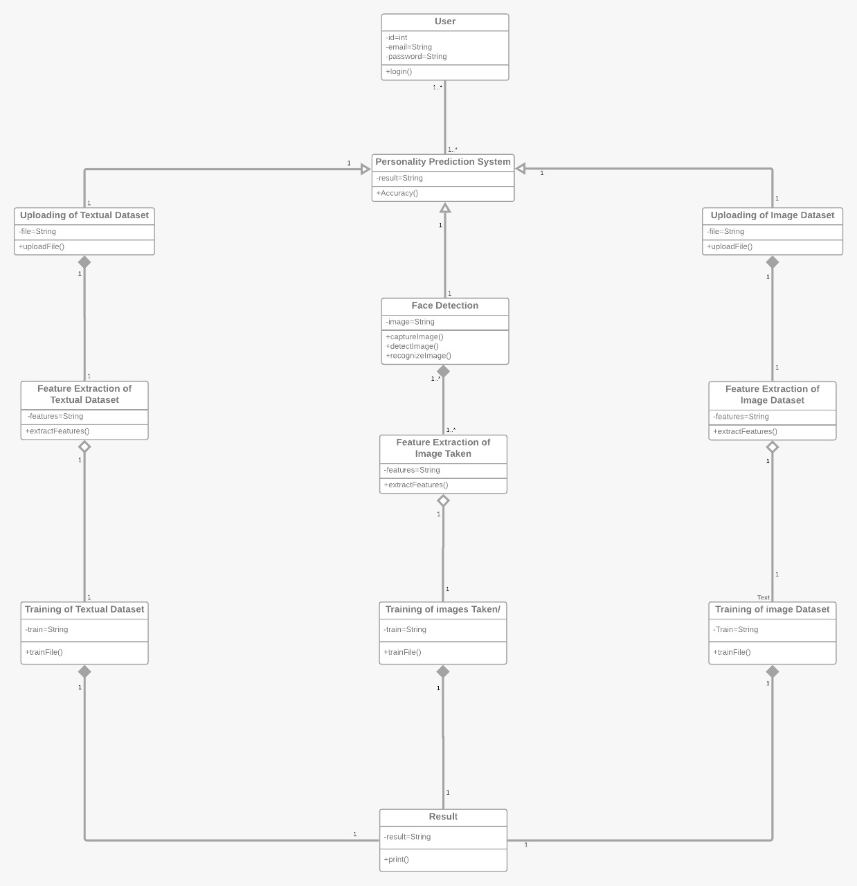
Class diagram
Mood Detection

Slide 9
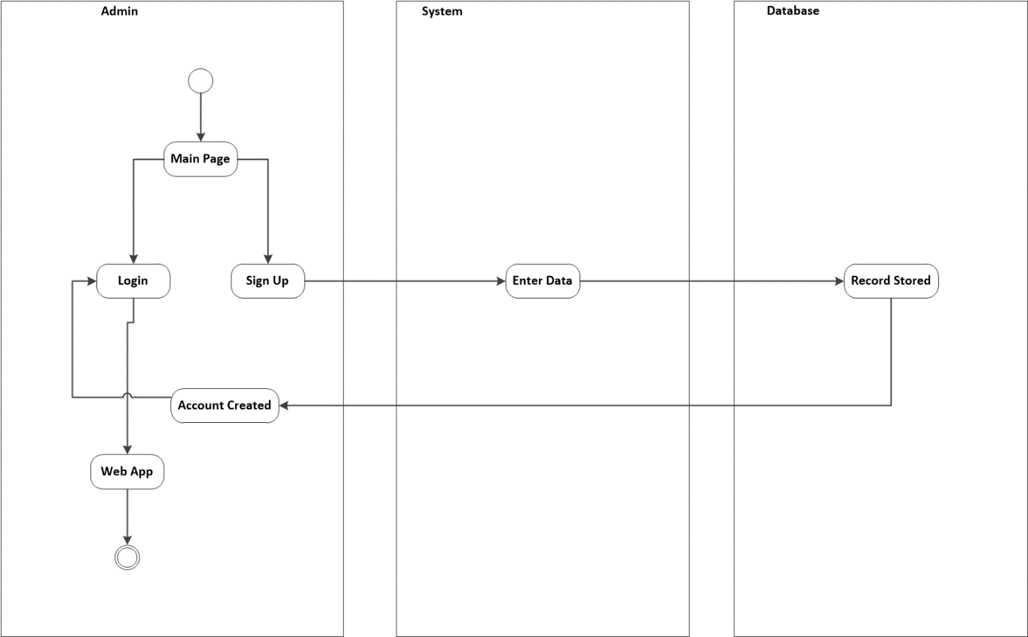
Activity Diagram
Sign Up

Slide 10
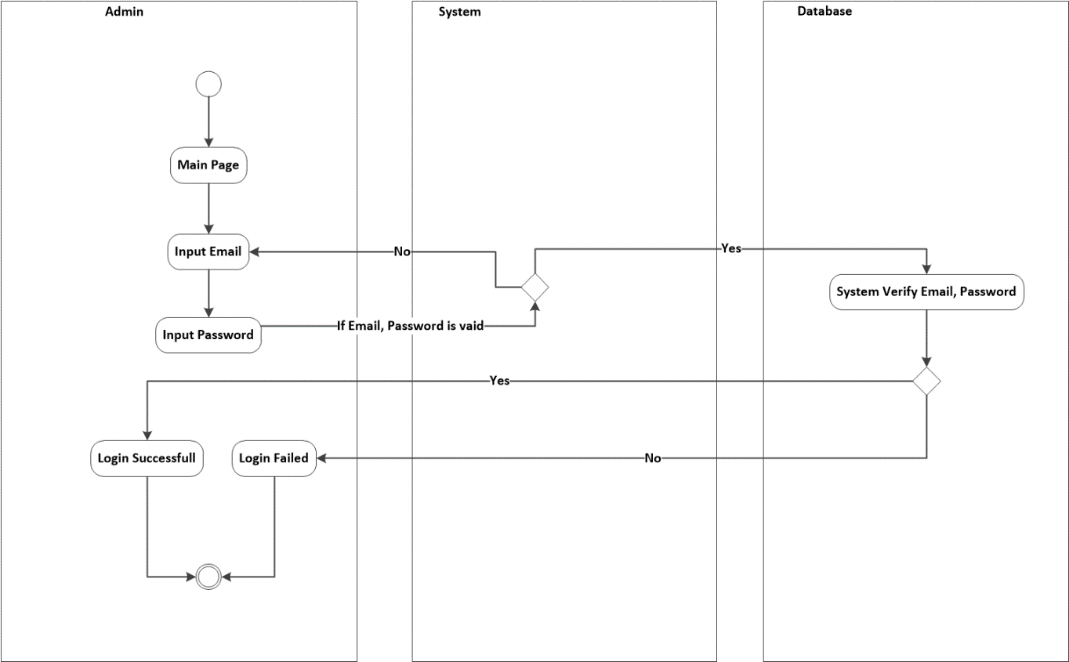
Activity Diagram
Login

Slide 11
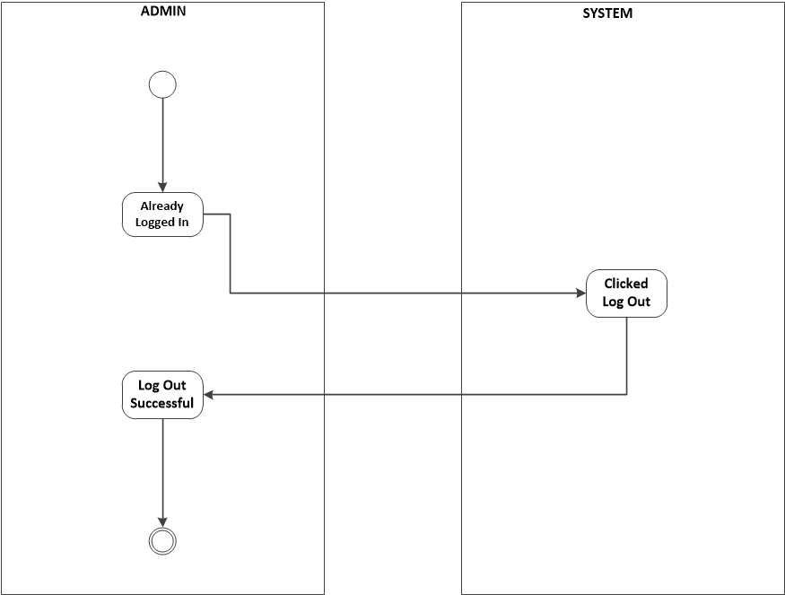
Activity Diagram
Log out

Slide 12
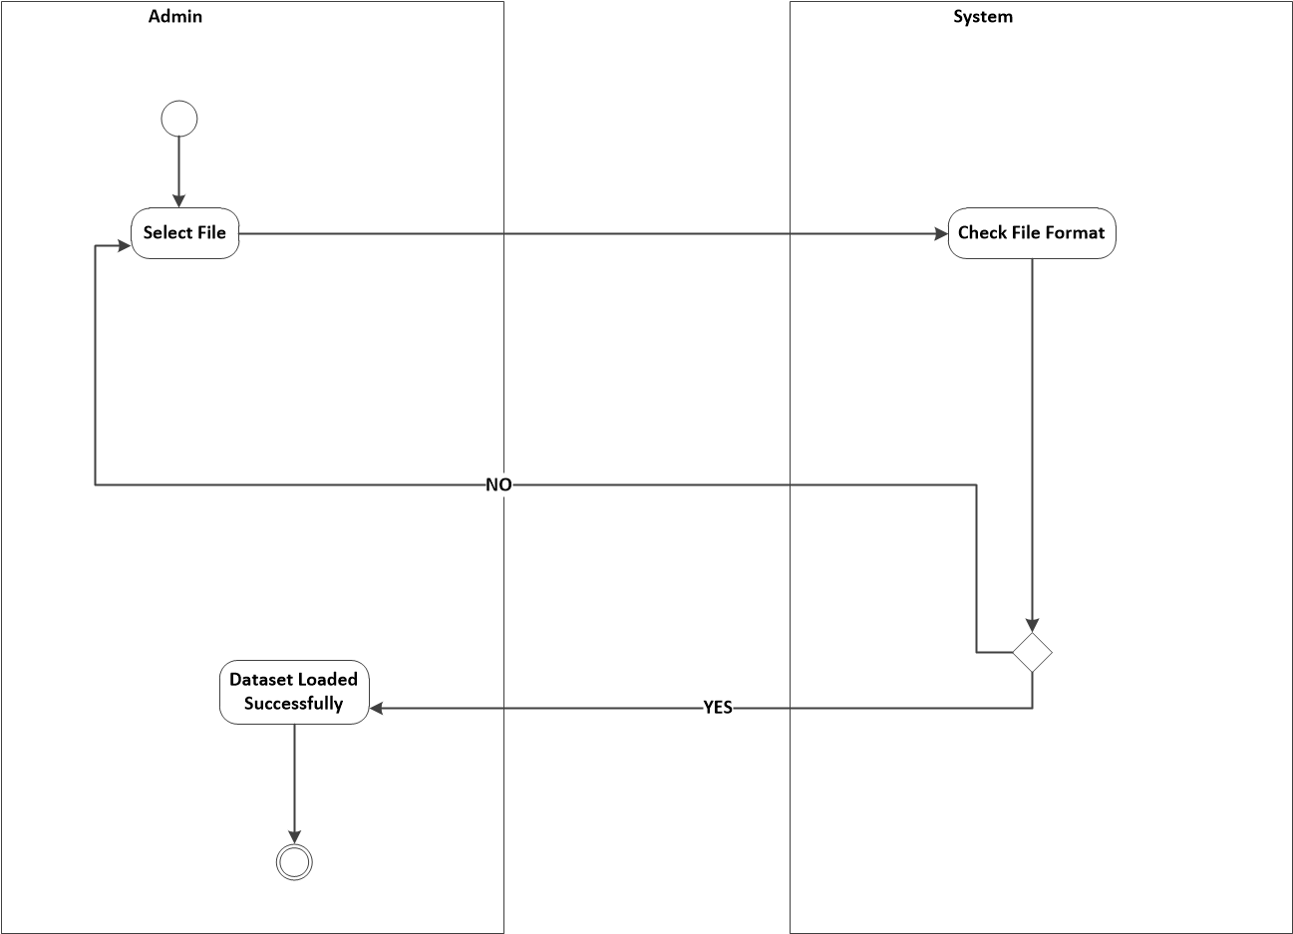
Activity Diagram
Loading of Textual Dataset

Slide 13
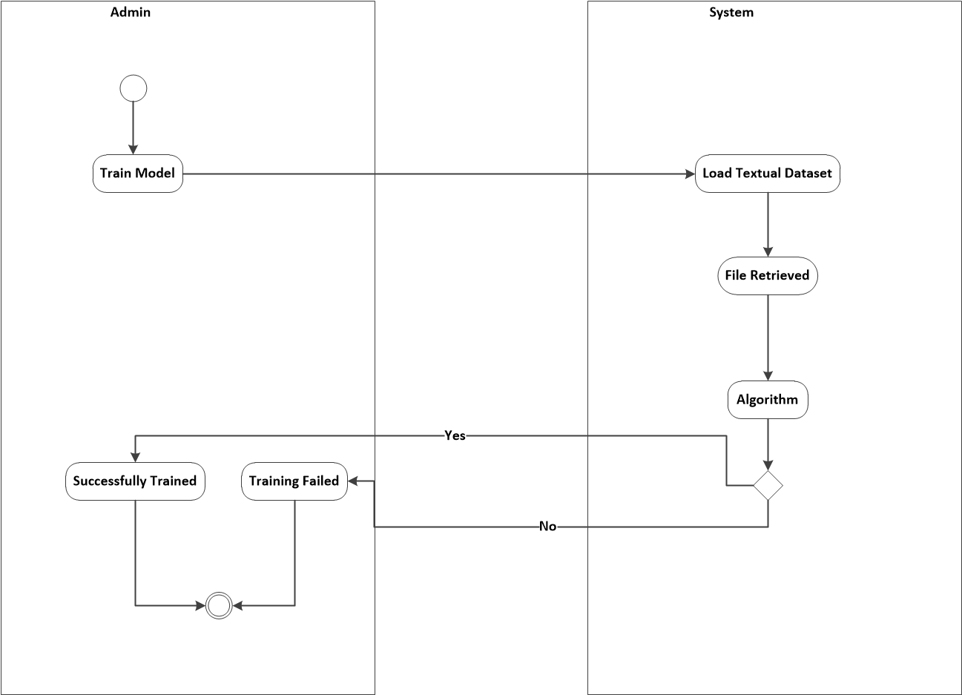
Activity Diagram
Training of Textual Dataset:

Slide 14
Activity Diagram
Loading of Image Dataset:

Slide 15

Activity Diagram
Training of Image Type Dataset:

Slide 16
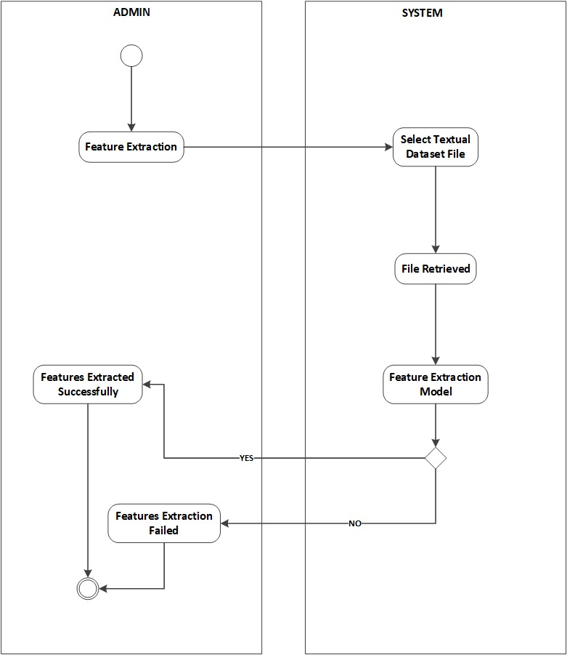
Activity Diagram
Feature Extraction Using Textual Dataset:

Slide 17
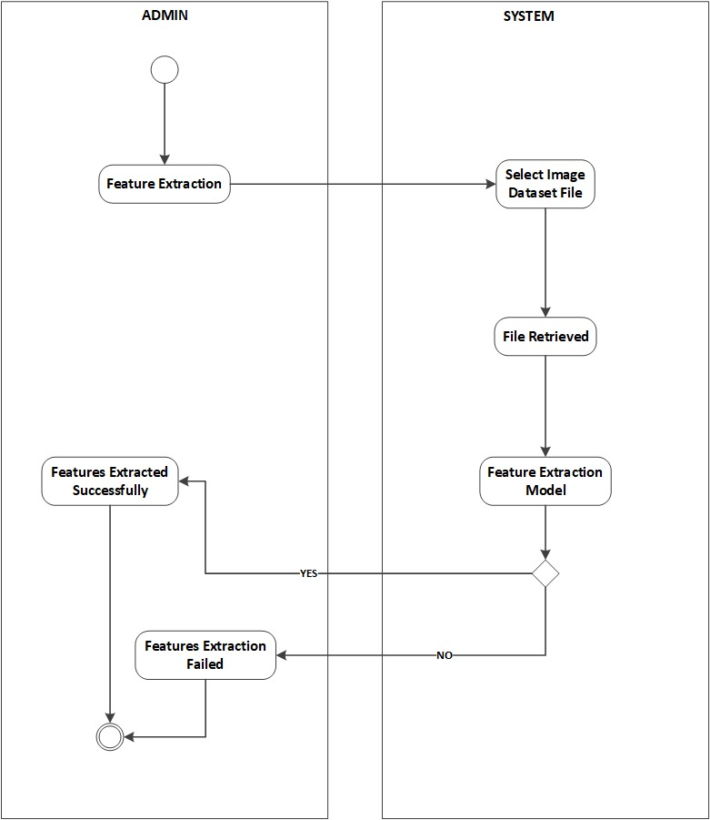
Activity Diagram
Feature Extraction Using Image Dataset:

Slide 18
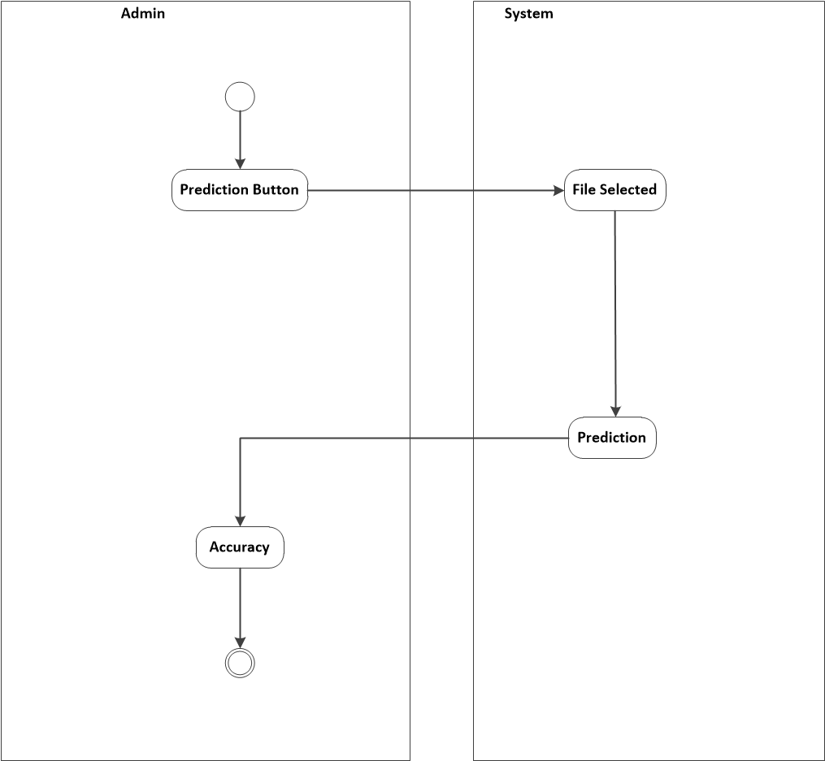
Activity Diagram
Personality Classification Using Textual Dataset:

Slide 19
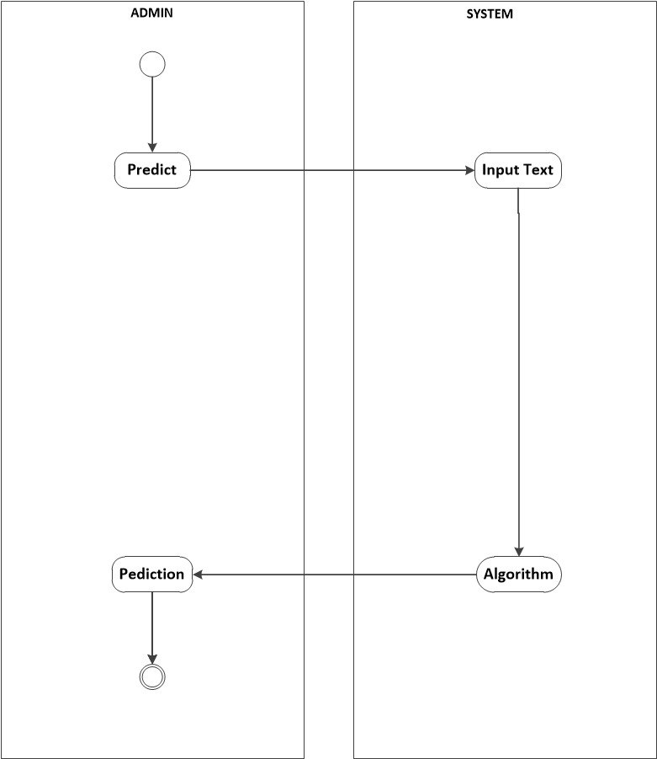
Activity Diagram
Personality Classification Using Textual Input:

Slide 20
Activity Diagram
Personality Classification Using Textual Input:

Slide 21
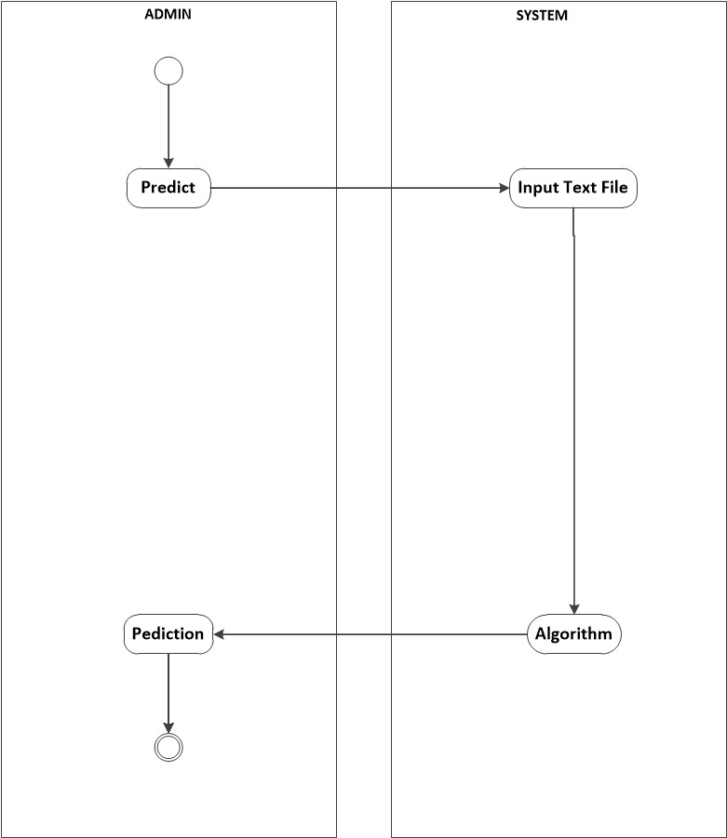
Activity Diagram
Personality Classification Using Textual File:

Slide 22
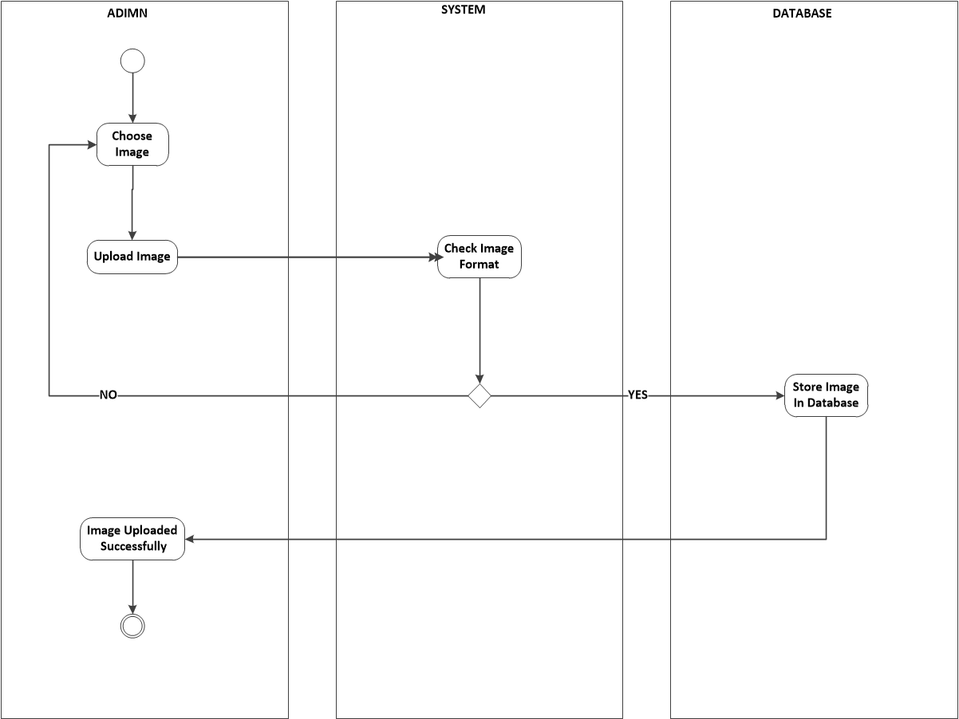
Activity Diagram
Upload Images:

Slide 23
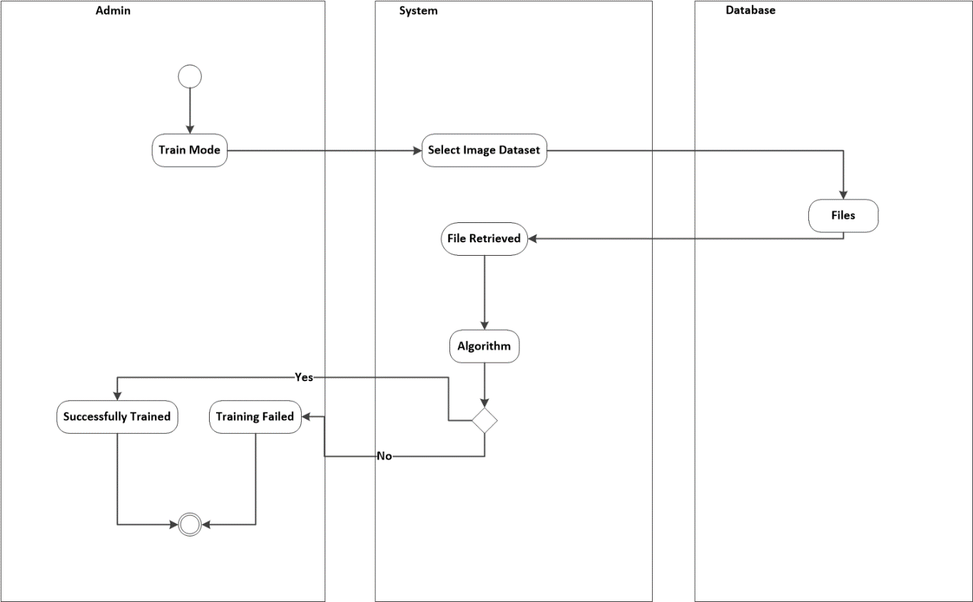
Activity Diagram
Training of Images

Slide 24
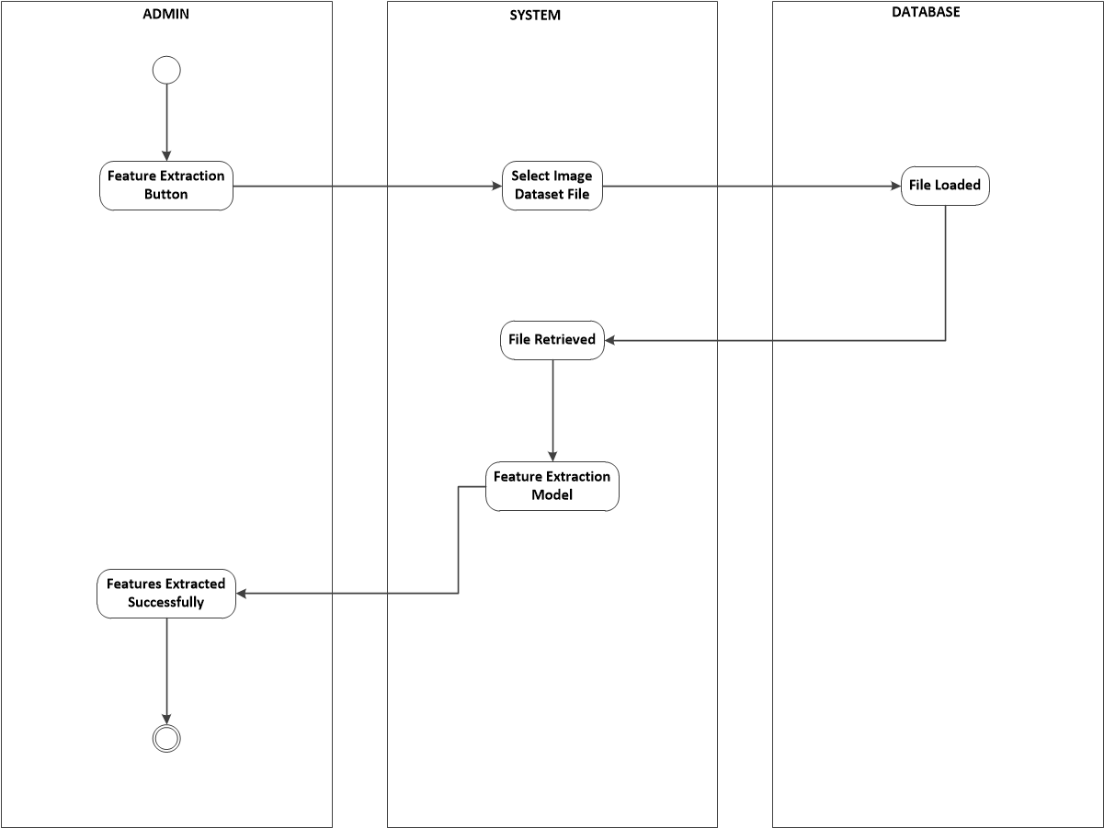
Activity Diagram
Feature Extraction using Uploaded Images

Slide 25

Activity Diagram
Personality Classification using Uploaded Image:

Slide 26
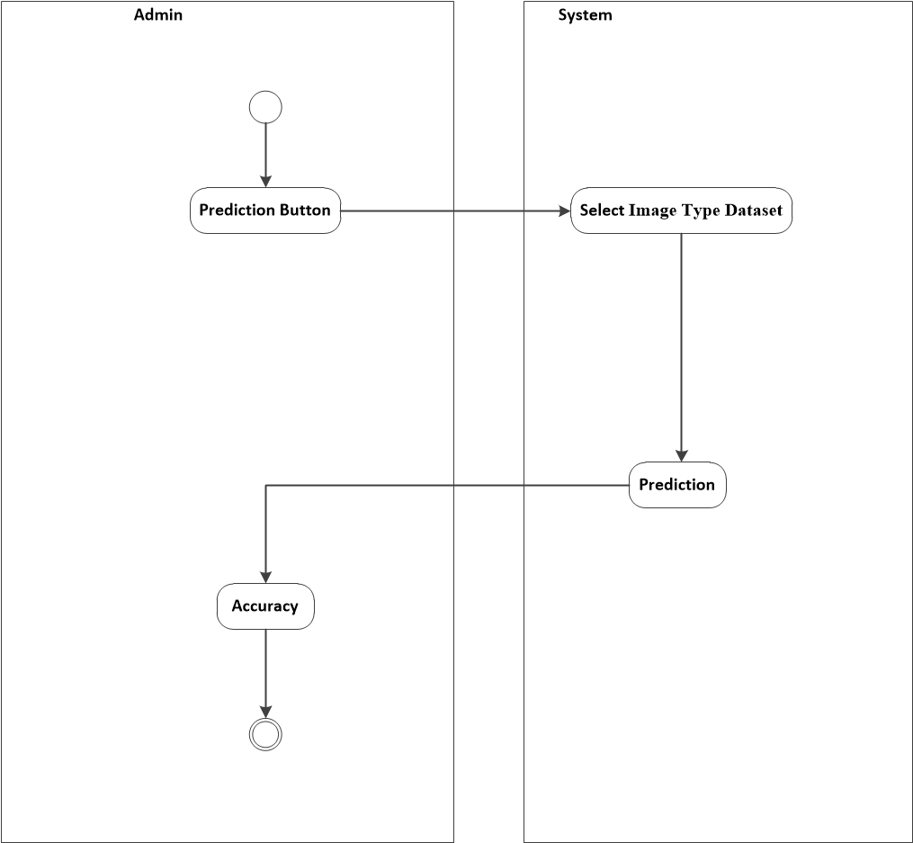
Activity Diagram
Personality Classification Using Image Type Dataset:

Slide 27
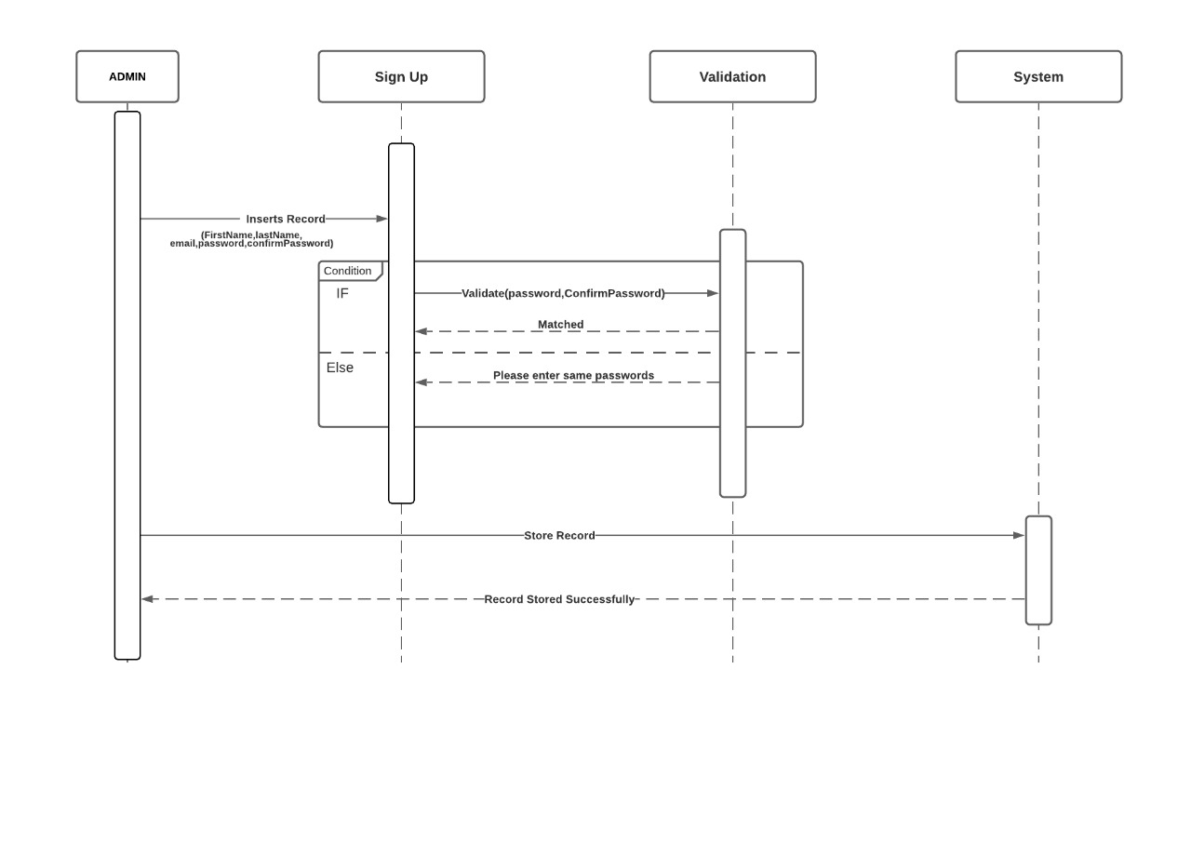
Sequence Diagrams
Sign Up:

Slide 28
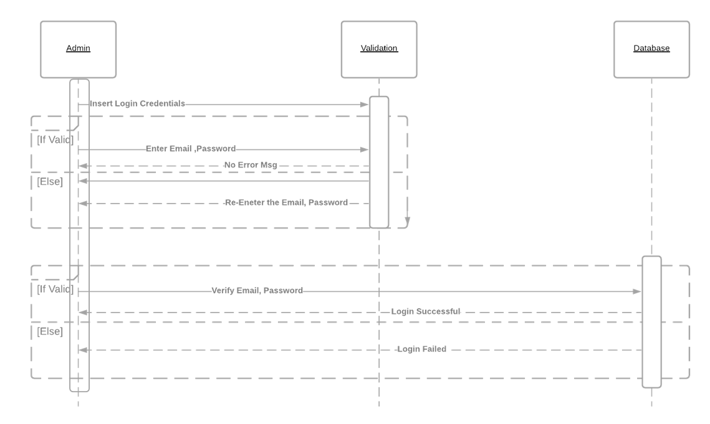
Sequence Diagrams
Log In:

Slide 29
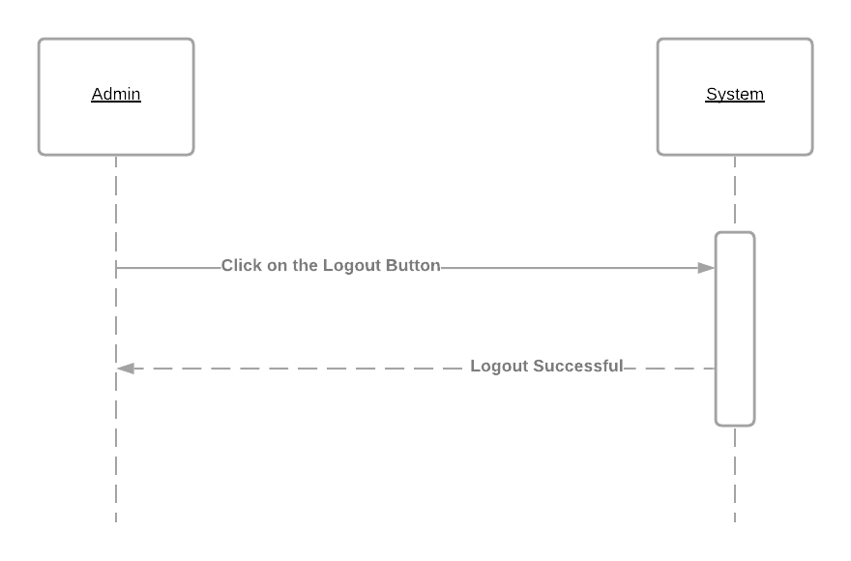
Sequence Diagrams
Log Out:

Slide 30
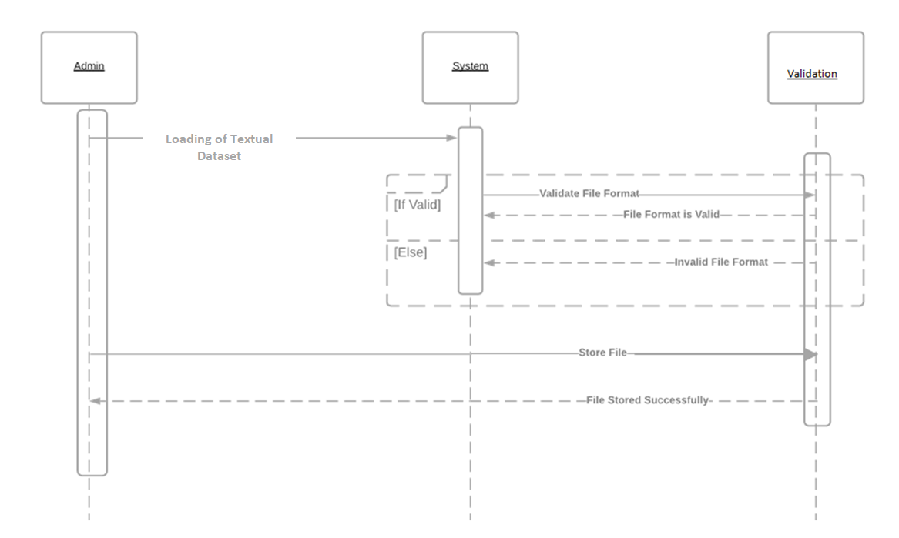
Sequence Diagrams
Loading of Textual Dataset

Slide 31
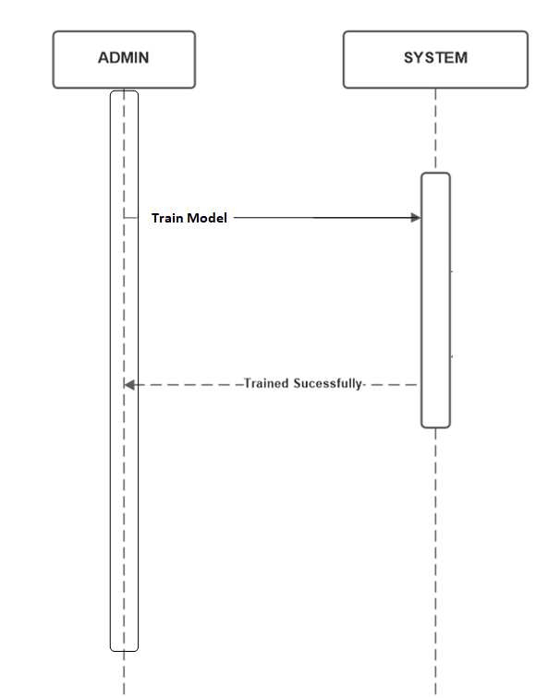
Sequence Diagrams
Training of Textual Dataset:

Slide 32
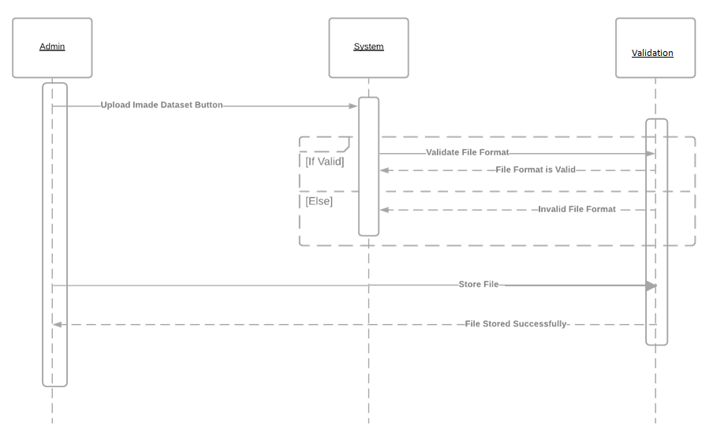
Sequence Diagrams
Loading of Image Dataset:

Slide 33
Sequence Diagrams
Training of Image Type Dataset:

Slide 34
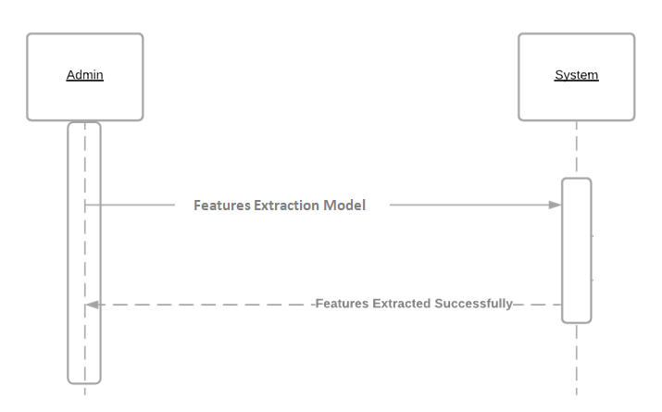
Sequence Diagrams
Feature Extraction Using Textual Dataset:

Slide 35
Sequence Diagrams
Feature Extraction Using Image Dataset:

Slide 36

Sequence Diagrams
Personality Classification Using Textual Dataset:

Slide 37
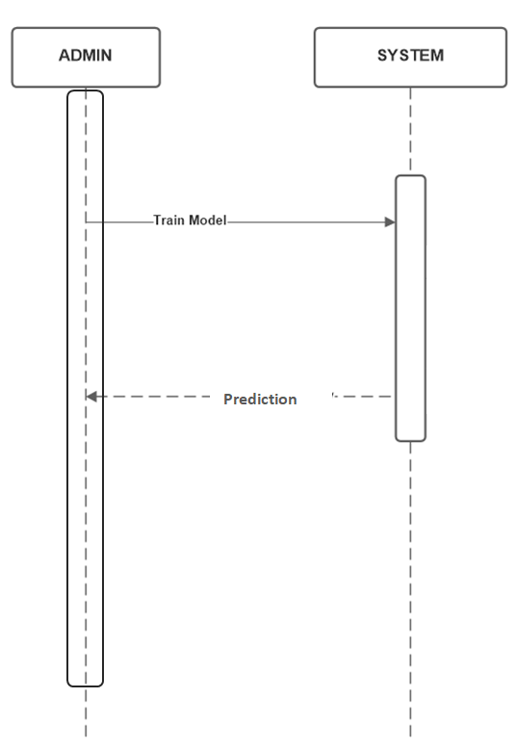
Sequence Diagrams
Upload Images:

Slide 38
Sequence Diagrams
Training of Images

Slide 39
Sequence Diagrams
Feature Extraction using Uploaded Images

Slide 40
Sequence Diagrams
Personality Classification using Uploaded Image:

Slide 41
Sequence Diagrams
Personality Classification Using Image Type Dataset:

Slide 42
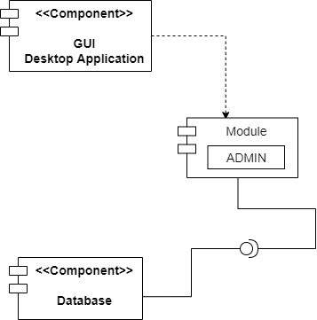
System Component Diagram

Slide 43
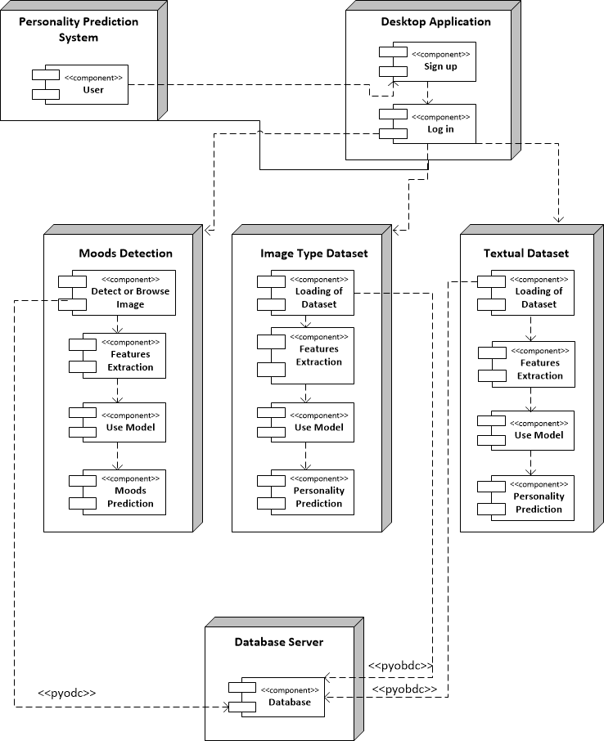
Deployment Diagram

Slide 44
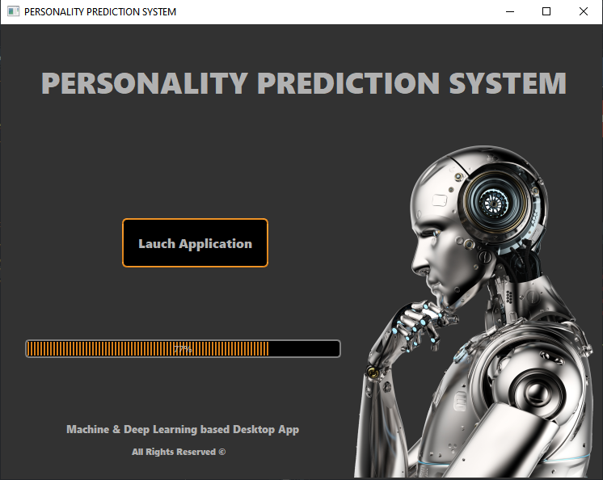
Project Screenshots

Slide 45
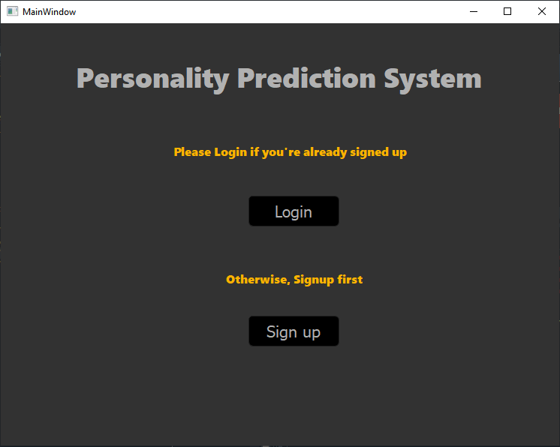

Slide 46
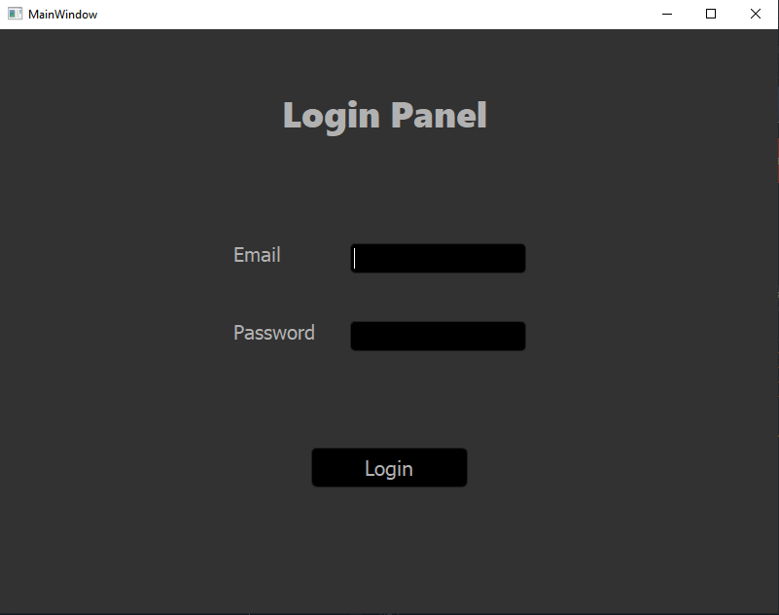

Slide 47
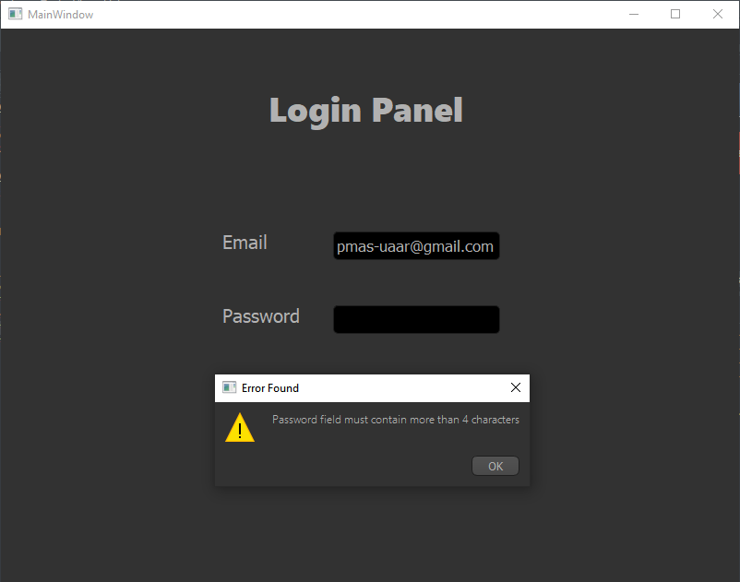

Slide 48
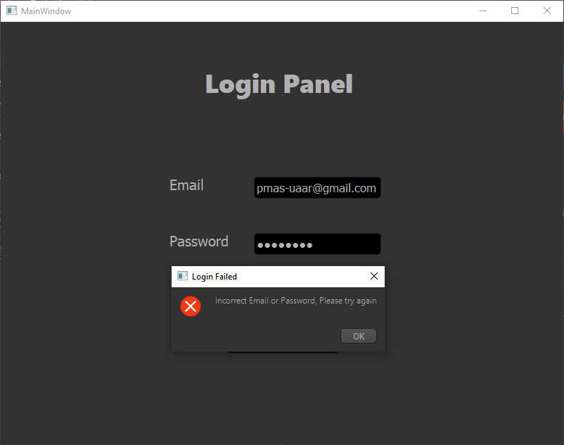

Slide 49
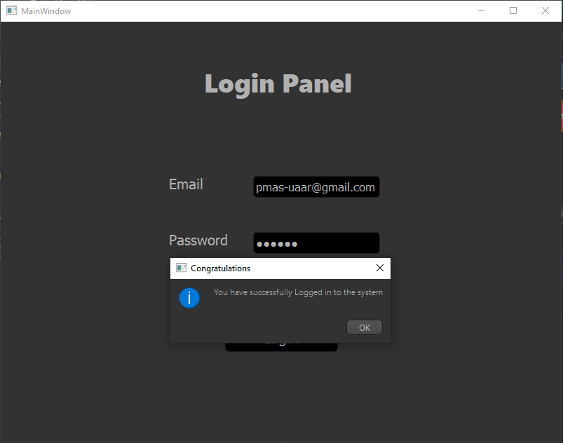

Slide 50
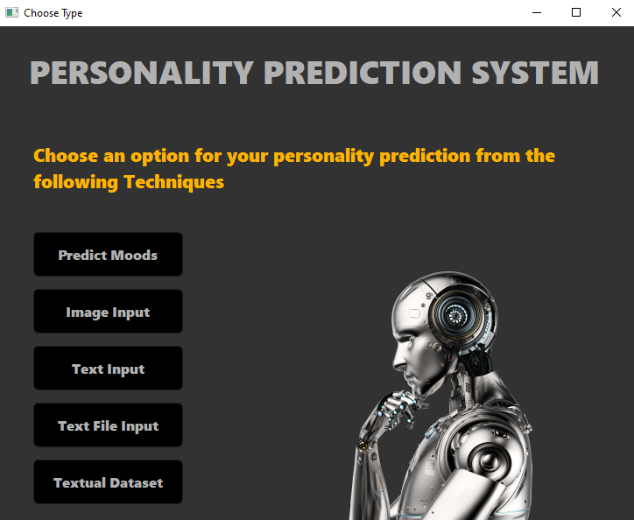

Slide 51
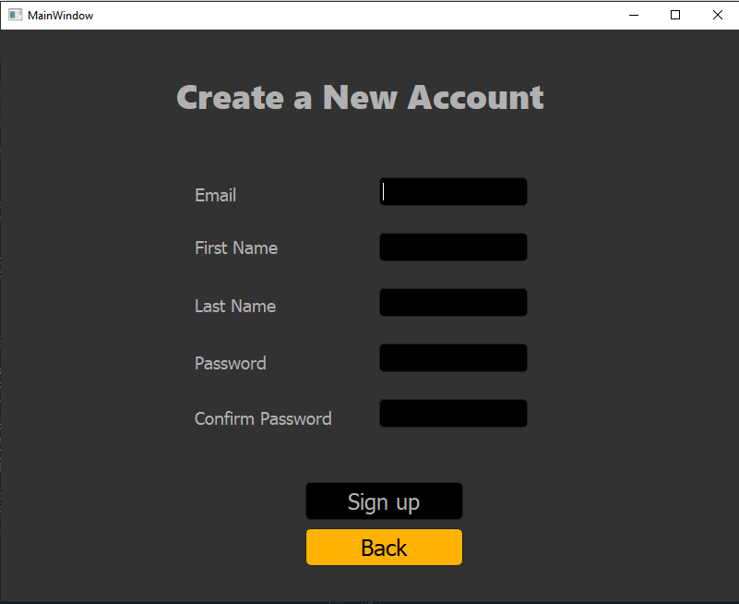

Slide 52
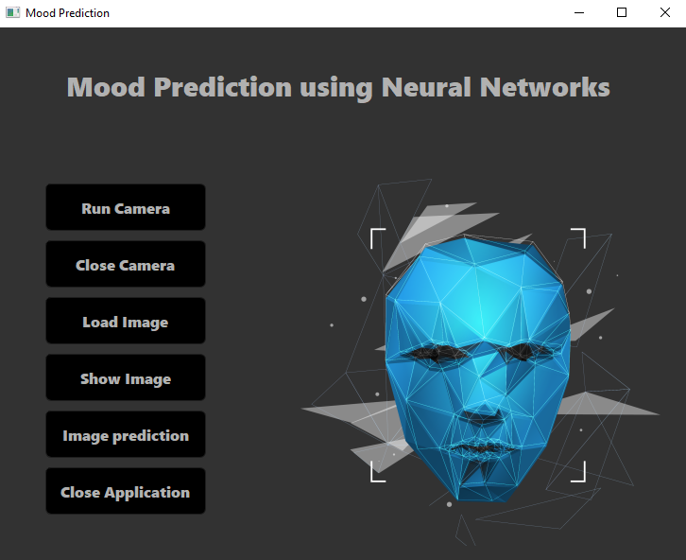

Slide 53
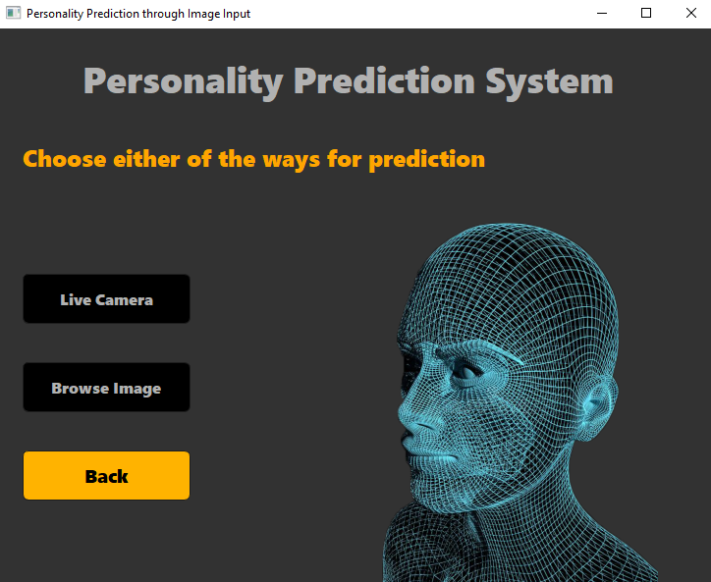

Slide 54
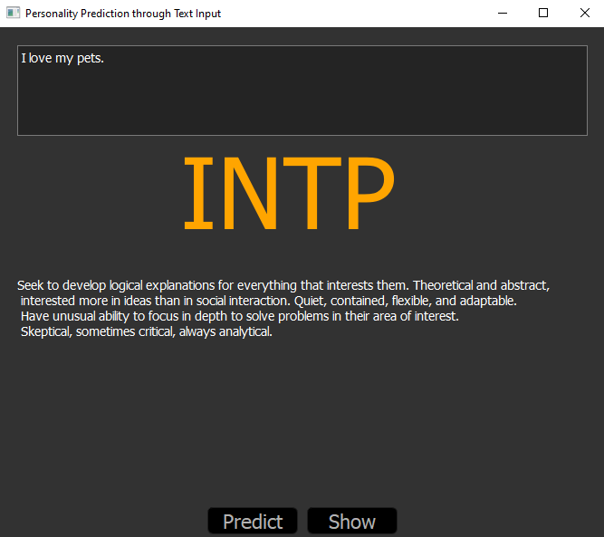

Slide 55
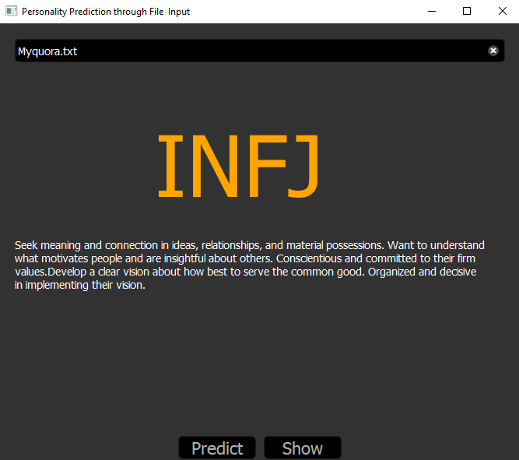

Slide 56
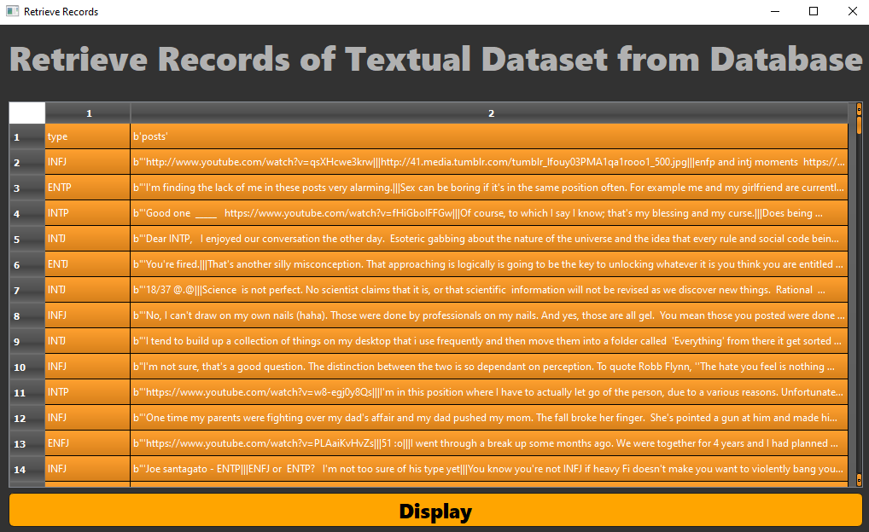

Slide 57
